Slide 1
VCE GREEK ORAL LANGUAGE EXAM

Slide 2
TIPS
Be on time.
Arrive 30 minutes before your allocated time.
Don’t forget your ID.
Bring a photo ID and your Student Advice Slip.
Be positive.
Focus on relaxing and being positive.
Confidence
Be confident, sure and clear in your responses
Don’t memorise your oral:
Memorizing chunks of information is not needed
Prepare strategies:
Have an idea how you will respond to unexpended question.
Engaging:
Focus on providing interesting and unusual answers.
Extend your response.
Avoid one-syllable answers.
Answer the question.
Try to lead on to the topic you would like to discuss.
Rephrase it.
If you don’t understand a question don’t hesitate to ask them to re-phrase it.

Slide 3
FACTS
Your oral examination will approximately take 15 minutes
A panel of two assessors appointed by the VCAA will examine you
12.5 % of this oral examination will contribute to your study score.

Slide 4
Oral examination
Your student number
You will find this number on your Student Advice Slip.
This must be said in English when the assessor asks you.
Your chosen topic
You must indicate to the assessor in Greek your chosen subtopic and show the supporting visual material that you have brought in to discuss in section 2.

Slide 5
Two sections
Section 1
Conversation – About the individual.
Approximately 7 minutes
Section 2
Discussion – Selected subtopic
Approximately 8 minutes

Slide 6
How it will begin
You will be waiting outside of the examination room and an assessor will ask you to come in.
You will work into the room and take a seat across from the assessors.
They will ask you to state your student number in English.
One of the assessors will ask the students to indicate in Greek your chosen subtopic and supporting visual material
An example of what they may ask is:
Ποιο είναι το θέμα που θα συζητήσετε στο δεύτερο μέρος;
An example responses may be:
Το θέμα που διάλεξα είναι ….. και η εικόνα μου είναι / και η εικόνα μου εμφανίζει….
Please note this information provided will not be assessed.

Slide 7
Section 1 Conversation
This will feel like a general conversation between you and the assessors.
You will conversate about:
Your personal world.
&
Your interaction with the Greek language and culture.
Section 1 is worth 20 marks .

Slide 8
Conversation Try to include interesting information about specific aspects of yourself. It is beneficial to practice this section and gather useful phrases for conversation.
Greetings
Καλησπέρα
Καλημέρα
Γεια σας
Family
Η οικογένεια μου αποτελείτε από…
Με την οικογένεια μου …
Future aspiration
Η μελλοντικές μου φιλοδοξείς είναι..
Θα ήθελα στο μέλλον να…
School / work
Τα μαθήματα που μελετώ είναι…
Το σχολείο είναι σημαντικό για μένα …
Interest / hobbies
Μου αρέσει να ταξιδεύω…
Λατρεύω το διάβασμα..

Slide 9
Preparation
Ideas that may help you prepare for this section are:
Ένα μέρος που θα ήθελα να ταξιδέψω...
Ένας συναρπαστικός άνθρωπος στη ζωή μου..
Ένα ενδιαφέρον βιβλίο που διάβασα..
Μια καλή ταινία που έχω δει...
(κατά προτίμηση στα ελληνικά)

Slide 10
Preparation
It is important to think about how you will prepare for question that will be asked about your interaction with the language and the culture.
Examples
Τι σε έκανε να επιλέξεις να σπουδάσεις αυτή τη γλώσσα στο VCE;
Τι δυσκολεύτηκες στη μελέτη της γλώσσας;
Τι σας φάνηκε εύκολο στη μελέτη της γλώσσας;
Πώς συντηρείτε τον ελληνικό πολιτισμό στην Αυστραλία;

Slide 11
Section 1 – Criteria
The conversation is worth 20 marks | Two criteria will be used to mark the student performance | Each is worth 10 marks.
Content and Communication
Information, ideas and opinions about the student’s personal world and their interactions with the language and culture as learners: Assessment Criteria
relevance, depth and range of information, ideas and opinions
capacity to elaborate and reflect on information, ideas and opinions
capacity to interact with assessors
effective communication
Language
Accurate and appropriate language structures and vocabulary related to the student’s personal world and their interactions with the language and culture as learners Assessment Criteria
appropriateness of vocabulary, grammar and sentence structures
clarity of expression, including pronunciation, intonation, stress and tempo

Slide 12
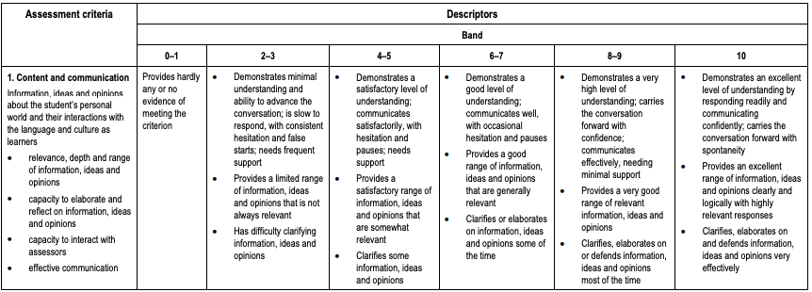

Slide 14
Section 2 Discussion
You must try to incorporate and speak about your image rather than wait to be asked about it.
Following on from section one you will be directed to move on to section two, the assessor may say:
Τώρα ας προχωρήσουμε στο δεύτερο κομμάτι.
This will feel like a discussion on your chosen subtopic which you will also interrelate with your visual material.
The subtopic you choose must be in the following themes:
‘The Second Language-speaking communities’
or
‘The world around us’
Section 2 worth 20 marks

Slide 15
Section 2 Discussion
Try to engage the assessors with eye contact and appropriate body language, supported by animated gestures and smiling
You need to elaborate on complex information and defend ideas and opinions clearly and logically with highly relevant responses
Students need to use the image creatively and effectively to support the discussion on the subtopic
Examples are:
... όπως απεικονίζει η εικόνα …
…αυτό το βλέπουμε και στην εικόνα…
If you are asked a question about an aspect which you have not covered or is not closely related to your subtopic, you should try to maintain the discussion and avoid a long awkward pause.
For example, you should either say politely to the assessors:
Λυπάμαι, δεν το έμαθα αυτό αλλά έχω μελετήσει.
Λυπάμαι, αλλά οι πόροι που χρησιμοποίησα δεν το ανέφεραν αυτό.
These are useful repair strategies. But you should be careful not to overuse them.

Slide 16
Preparation
Try to emphasise your opinions and ideas through appropriate intonation and stress and maintain the tempo well.
There should be plenty of interaction between you and assessors.
You may be interrupted if a prepared answer is too long.
It is important to exploring aspects such as opinions, information and ideas for your subtopic.
You can use supportive documents such as: books, newspaper articles, documentaries, movies, interviews, images and or songs. To gather information on the subtopic.
Make sure the sources are reliable and relevant to your prescribed subtopic.

Slide 17
Visual material
Allowed
One image.
Paper no larger than A3.
No writing on the image and if there is there must be minimal e.g. a heading or a title.
Not Allowed
Three dimensional objects.
Dictionaries, notes and cue cards.

Slide 18
Image
You must include your image in your discussion do not wait for them to ask you.
Find a link that will help you talk about the image and how it interrelates with your subtopic.
You may want to discuss the relation your image has with the subtopic by speaking on specific elements in the image that relate to your topic.
You may want to use the origin and or the motive of the image to connect to your subtopic.
You will not be describing the whole content of the image; you rather will use the content to illustrate what you are saying about the subtopic.

Slide 19
Preparation This is food for thought which can help you then generate answers strategically.
Create a range of questions that you may ask or have about the prescribed subtopic.
Answer these questions in detail.
Write a summary of your subtopic and then expand this summary with your opinions.
If you are looking at differences in a topic you may want to collate a few similarities and differences in a paragraph or dot point form.
You may want to write your ideas and thoughts that you have on the subtopic including feelings and emotions that this topic may provoke.

Slide 20
How it may begin
Starting off they may ask you a broad question on your topic such as:
Έχετε μελετήσει το θέμα… τι μπορείτε να μας πείτε για αυτό το θέμα….
You may take time here to explain your topic specifically and go into detail on the main bits of information you will be elaborating. At this stage you may find an appropriate cue to engage your image by saying
όπως μπορείτε να δείτε σε αυτή την εικόνα….. δείχνει πώς
You can use the image to discuss technical aspects of your oral. Then you would link that to new ideas so then you can move on.

Slide 21
Section 2 - Criteria
The discussion is worth 20 marks | Two criteria will be used to mark the student performance | Each is worth 10 marks.
Content and Communication
Information, ideas and opinions related to the chosen subtopic and supporting visual material from either the prescribed theme ‘The (Language)-speaking communities’ or the prescribed theme ‘The world around us’
Assessment criteria:
relevance, depth and range of information, ideas and opinions
capacity to elaborate and reflect on information, ideas and opinions
capacity to interact with assessors
effective communication
Language
Accurate and appropriate language structures and vocabulary related to the chosen subtopic and supporting visual material from either the prescribe theme ‘the (Language)-speaking communities’ or the prescribed theme ‘The world around us’
Assessment Criteria:
appropriateness of vocabulary, grammar and sentence structures
clarity of expression, including pronunciation, intonation, stress and tempo

Slide 22
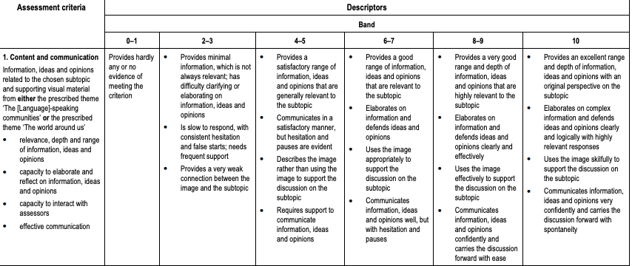

Slide 23
